Slide 1
Dungeon Buddy
A D&D project by David Gereau

Slide 2
What is Dungeons and Dragons?
Table-Top Role Playing Game
Collective Story-Telling based on interactions between:
Players (Characters)
Game Master (Arbitrator of Events)
Dice!
Plight of the Game Master
World Building
Story Planning
Non-Player Character Creation
Encounter Building and Management
How can we simplify or automate these tasks?

Slide 3
Project Idea: DungeonBuddy is born!
The Two Overarching Goals:
Allow Game Masters to create digital representations of their games, so that they can better levy technology to do some of the heavy lifting.
Allow a game’s players to access these games, so that they can view game specific information that their Game Master makes available.

Slide 4
Project Specifications
Game Masters
Be able to create a digital representation of their Table-Top game
View and Manage which Player Characters are in the Game (Party System)
Be able to create and manage unique ‘Monster’ encounters, and save them for use during their game.
Track a List of Game Non-Player characters.
Be able to generate random Non-Player characters for their game.
Be able to digitally roll all types of dice with custom modifiers.
Be able to publish custom Game Information pages for Players to be able to access (Maps, World Information, etc).
Player
View Basic Game Information for each game they are a part of.
Be able to view all other Party Members in each game they are a part of (View Party)
Be able to see any World information made available by their Game Master.

Slide 5
Functional Requirements

Slide 6
Main Screen (Navigation)
Main Page
FR1 | If not logged in, the user should be redirected to the login screen.
FR2 | The user should be able to view all of the games in which they are the Game Master
FR3 | The user should be able to view all of the games in which they are a player.
FR4 | The user should be able to navigate to the Home Screen.
FR5 | The user should be able to navigate to the Create New Game screen.
FR6 | The user should be able to navigate to the Join Game screen.
FR7 | The user should be able to navigate to the Game Information Screen for any game that they are a player of.
FR8 | The user should be able to navigate to the Game Party Screen for any game that they are a player of.
FR9 | The user should be able to navigate to any Custom Game pages included with any game that they are a player of.
FR10 | The user should be able to navigate to the Game Information Screen for any game that they are a Game Master of.
FR11 | The user should be able to navigate to the Game Party Screen for any game that they are a Game Master of.
FR12 | The user should be able to navigate to the Encounter Tool for any game that they are a Game Master of.
FR13 | The user should be able to navigate to the NPC Tracker for any game that they are a Game Master of.
FR14 | The user should be able to navigate to the NPC Tool for any game that they are a Game Master of.
FR15 | The user should be able to navigate to the Custom Page Tool for any game that they are a Game Master of.

Slide 7
Login Screen (Login/Registration)
Login Screen
FR1 | The user should be able to authenticate a username and password against a user entry in the database
FR2 | The user should be able to fill out a form to gather the required information to create a new account.
FR3 | The user should be able to create a new user account in the database.

Slide 8
Home Screen (Greeting / Tutorials)
Home Screen
FR1 | If not logged in, the user should be redirected to the login screen.
FR2 | The user should be able to read the Web Page greeting.
FR3 | The user should be able to read instructions on how to navigate the various pages.

Slide 9
Create Game Screen (For New GMs)
Create Game Screen
FR1 | If not logged in, the user should be redirected to the login screen.
FR2 | The user should be able to fill out a form to gather the required information to create a game.
FR3 | Game name should be checked against a database to ensure that it does not already exist.
FR4 | The user should be able to create their game in the database, and be assigned its Game Master

Slide 10
Join Game Screen (For New Players)
Join Game Screen
FR1 | If not logged in, the user should be redirected to the login screen.
FR2 | The user should be to view all the games currently accepting new players.
FR3 | The software should be to access the names of all of the games in the database.
FR4 | The user should be able to fill out basic information for a game they would like to join.
FR5 | The software should forward the user’s information as a join request to the Game Master of the game.

Slide 11
Game Information Screen (For Game Masters and Players)
(Player) Game Information Screen
FR1 | If not logged in, the user should be redirected to the login screen.
FR2 | The software should retrieve the stored game information text from the database.
FR3 | The user should be able to read the game information written by the Game Master.
(Game Master) Game Information Screen
FR1 | If not logged in, the user should be redirected to the login screen.
FR2 | The software should retrieve the current stored game information text from the database.
FR3 | The user should be able to update any of the existing game information.
FR4 | The software should update the game’s information in the database with any changes made by the Game Master.

Slide 12
Game Party Screen (For Game Masters and Players)
(Player) Game Party Screen
FR1 | If not logged in, the user should be redirected to the login screen.
FR2 | The software should retrieve all party members belonging to the game from the database.
FR3 | The user should be able to view the list of current party members, and all of their current information.
(Game Master) Game Party Screen
FR1 | If not logged in, the user should be redirected to the login screen.
FR2 | The software should retrieve all party members belonging to the game from the database.
FR3 | The user should be able to view the list of current party members, and all of their current information.
FR4 | The user should be able to edit any of the information belonging to any of the individual party members.
FR5 | The user should be able to view and accept any join requests to the game.
FR6 | The user should be able to create and add NPC Party Members to the game.
FR7 | The software should update any updated party member information to the database.

Slide 13
Custom Page Tool (For Game Masters and Players)
(Player) Custom Game Page Screen
FR1 | If not logged in, the user should be redirected to the login screen.
FR2 | The user should be able to view the game master’s custom pdf page.
(Game Master) Custom Page Tool
FR1 | If not logged in, the user should be redirected to the login screen.
FR2 | The software should be able to retrieve the names and ordering of all the current custom pages from the database.
FR3 | The user should be able reorder the existing custom pages.
FR4 | The user should be able to delete existing custom pages.
FR5 | The user should be able to add additional custom pages.
FR6 | The software should be able to save uploaded pdf pages to server storage.
FR7 | The software should be able to deny the upload of pdf pages with excessive disk usage.
FR8 | The software should be able to insert new custom pages into the database with urls to the pdf pages in server storage.
FR9 | The software should be able to delete pdfs from server storage and the database when no longer needed.
FR10 | The software should be able to update custom page order in the database.

Slide 14
Encounter Tool (For Game Masters)
(Game Master) Encounter Tool
FR1 | If not logged in, the user should be redirected to the login screen.
FR2 | The software should be able to retrieve the names of all current encounters from the database.
FR3 | The user should be able to make new encounters.
FR4 | The user should be able to load existing encounters from the database.
FR5 | The user should be able to add monsters to their new or existing encounter.
FR6 | The user should be able to edit individual monster characteristics.
FR7 | The user should be able to save their new encounter for later use.
FR8 | The software should be able to save new encounters and their monsters to the database.
FR9 | The software should be able to update existing encounters and their monsters to the database.
FR10 | The software should be able to delete existing encounters and their monsters to the database.
FR11 | The user should be able to run game encounters from the tool in actual play.

Slide 15
NPC Tool and NPC Tracker (For Game Masters)
(Game Master) NPC Tool
FR1 | If not logged in, the user should be redirected to the login screen.
FR2 | The software should be able to retrieve pre-made NPC characteristics at random from the database.
FR3 | The user should be able to randomly generate every required characteristic for an NPC.
FR4 | The user should be able to manually edit any required characteristic for the NPC.
FR5 | The user should be able to save the generated or created NPC for later use.
FR6 | The software should be able to save the NPC to the database.
(Game Master) NPC Tracker
FR1 | If not logged in, the user should be redirected to the login screen.
FR2 | The software should be able to retrieve all of a game’s NPCs from the database.
FR3 | The user should be able to see a list of all of the game’s NPCs, with basic identifying information.
FR4 | The user should be able to select any NPC, and display all of its data.
FR5 | The user should be able to edit any characteristics of that NPC.
FR6 | The user should be able to update any changes to the game’s NPCs.
FR7 | The user should be able to delete any given NPC.
FR8 | The software should update any changes to NPCs in the database.
FR9 | The software should be able to delete any given NPC from the database.

Slide 16
Non-Functional Requirements

Slide 17
Web Server Requirements
The Web Application will need both a Web Server as Middleware, and a Database to handle the back-end storage of data.
Due to expected low traffic, these two components will be ran on the same platform.
The Server must be able to handle moderate levels of disk space required for storage of User PDF files, which may contain images.
Database queries will need to be executed within 150ms to ensure the user is able to make the quick alterations needed to run in-game tabletop combats.

Slide 18
Front-End Device Requirements
The software will need to be deployed as both an Asp.Net Web Application for Windows and macOS users with browser internet access.
Project also includes a secondary project to integrate database access to an existing Microsoft Windows Desktop Application, so that Windows users temporarily without internet access may still utilize Online content whilst running their games via Import/Export and Authentication features.

Slide 19
Design Documents

Slide 20
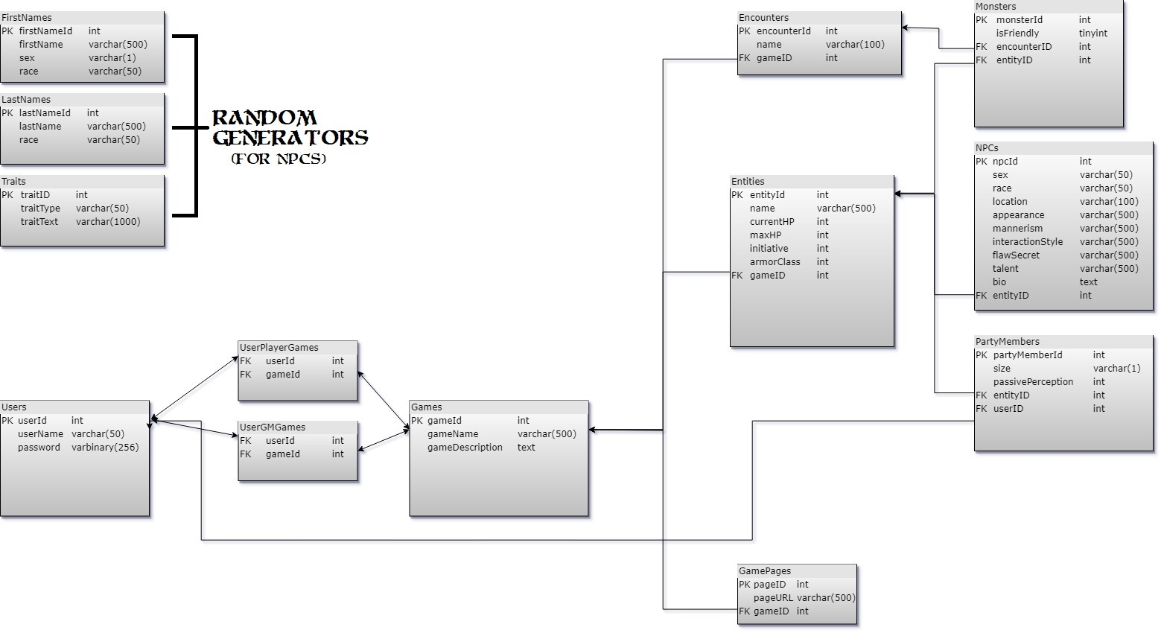
Database Diagram

Slide 21
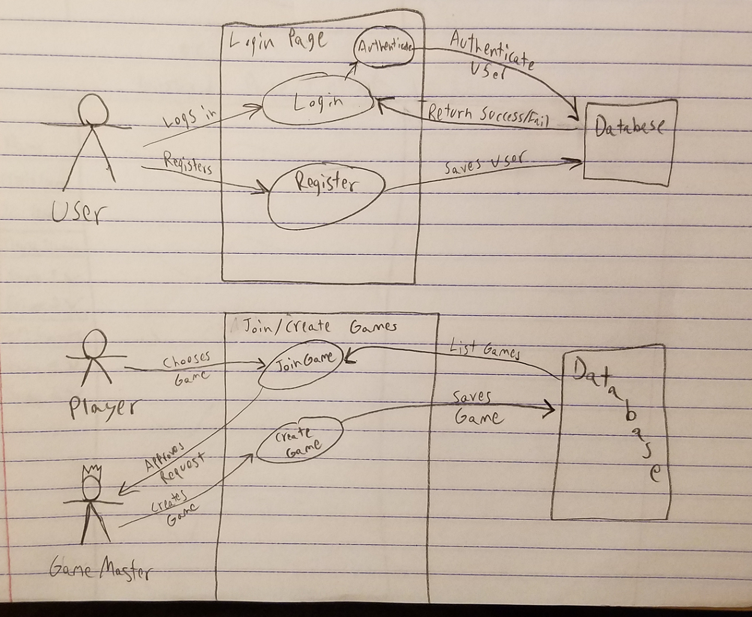
Use Cases (See Asp.Net Prototype)

Slide 22
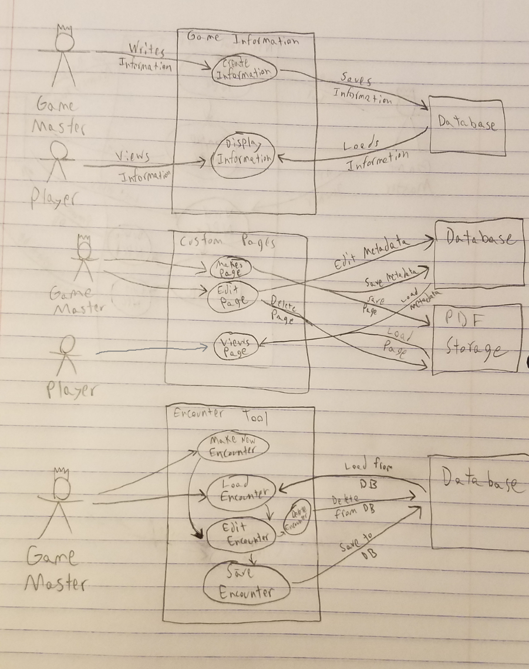
More Use Cases (See Asp.Net & C# Prototype)

Slide 23
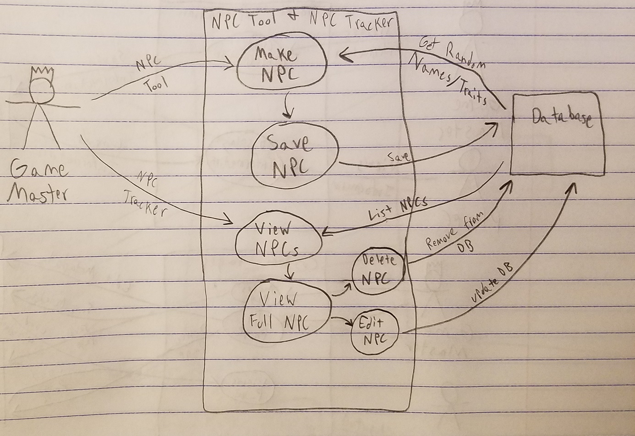
Even More Use Cases! (See C# Prototype)

Slide 24
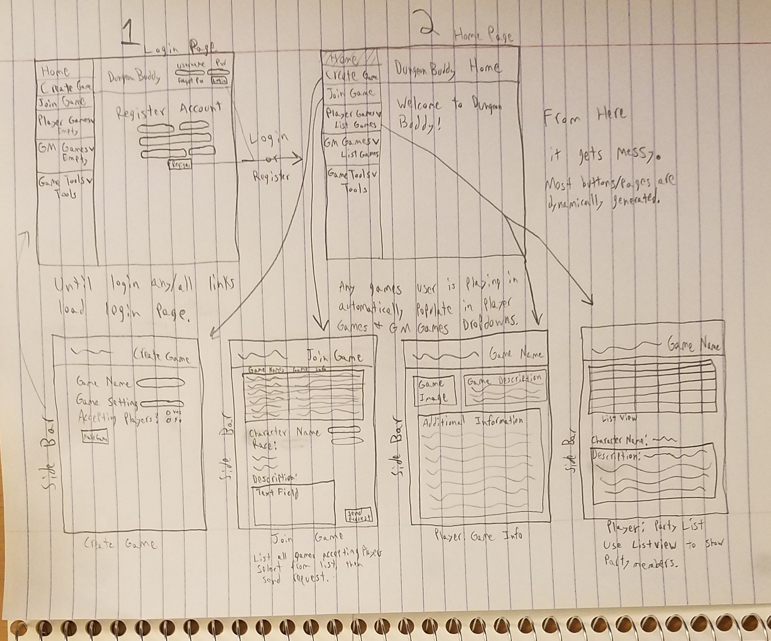
Storyboard Page 1

Slide 25
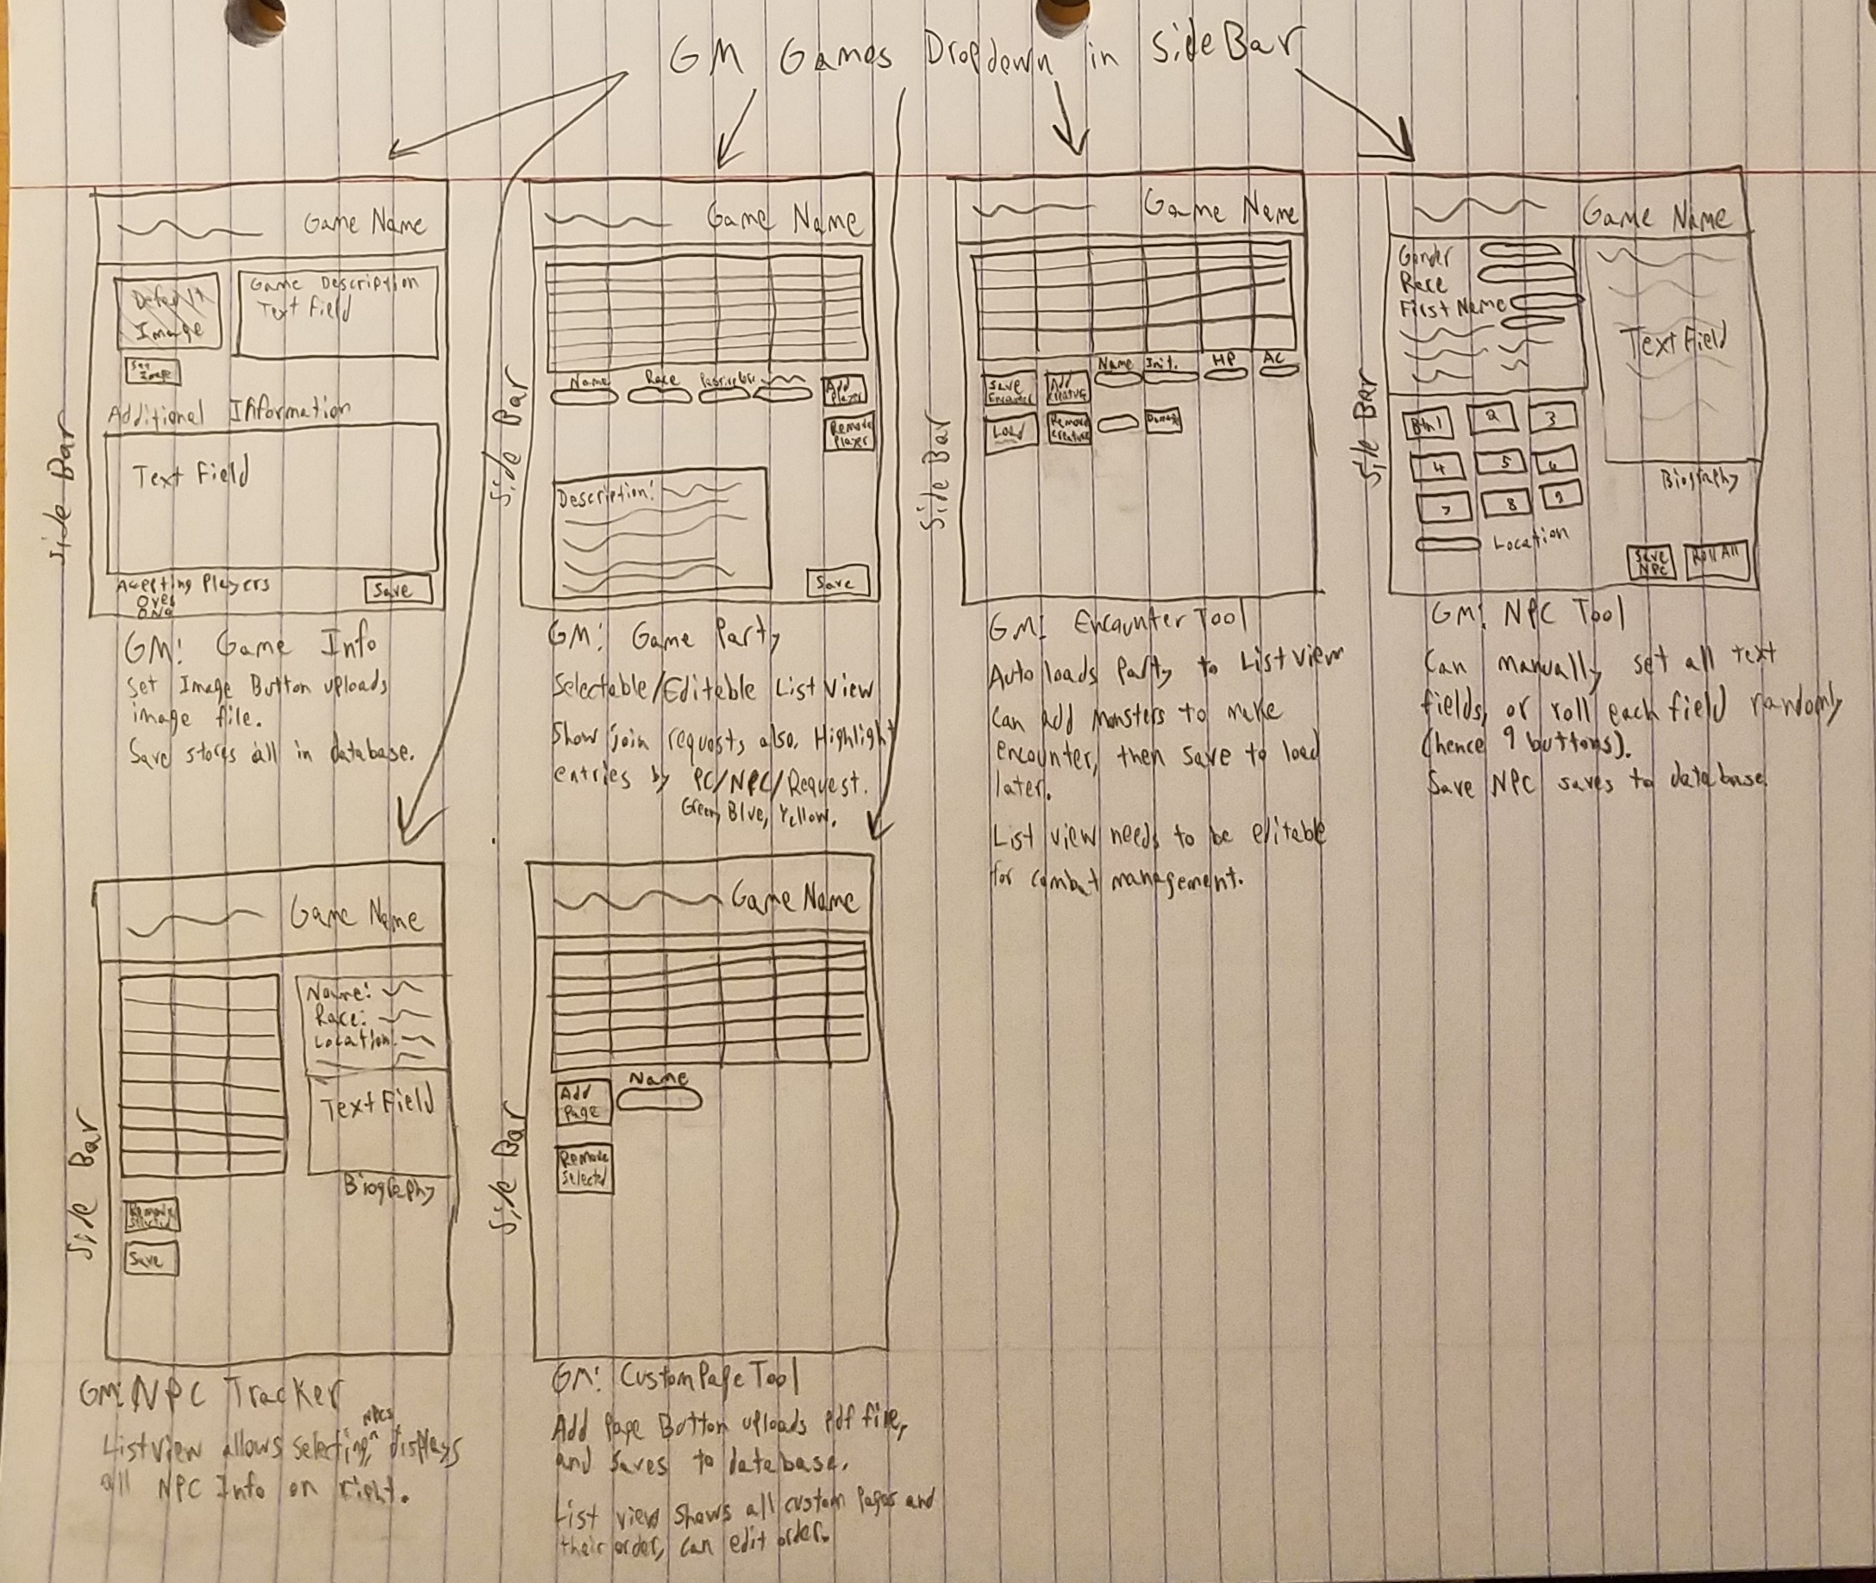
Storyboard Page 2

Slide 26
Timeline

Slide 27
Timeline
Week 1 (Oct 14 – Oct 20)
• Reach Design decision on use of Grid View, ListView, or my own Object Table, for the many tables I need.
Week 2 (Oct 21 – Oct 27)
• Login/New User registration completion
• Encounter Tool completion
Week 3 (Oct 28 – Nov 3)
• ‘Create Game’ Page completion
• ‘Join Game’ Page completion
• ‘Game Party’ Page completion
Week 4 (Nov 4 – Nov 10)
• NPC Tool completion
• NPC Tracker completion
Week 5 (Nov 11 – Nov 17)
• Custom Game pages completion
• Create Game Information Page
• Begin Optimization
Week 6 (Nov 18 – Nov 24)
• Begin Project Testing
• Finalize any remaining functionality of Main Project
• Begin work on secondary project (Desktop app)
Week 7 (Nov 25 – Dec 1)
• Complete login/authentication feature of Desktop application
• Complete Desktop application’s ‘Import/Export’ functionality
Week 8 (Dec 2 – Dec 8)
• Present Project Demo and Testing
◦ Testing Complete
◦ Working Demo Complete

Slide 28
Estimates
Estimated Time to Completion of Main Project: 6 weeks
Estimated Time for Secondary Project: 2 weeks
Possible Stretch-Goals:
Magic Item Shop Generator
Treasure Generator
Settlement Generator

Slide 29
Questions?

